Slide 1
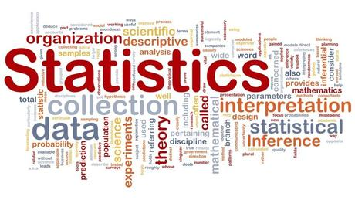


An Introduction to Statistical Learning
with Applications in R
Gareth James • Daniela Witten • Trevor Hastie • Robert Tibshirani

Slide 2
Agenda
Introductions
Objectives
Basic rules
Guidelines/Logistics
Schedule
Chapter 2: Statistical Learning
2.1: What Is Statistical Learning?

Slide 3

Introductions
Who are you?
Why are you here?
What are your expectations?

Slide 4
Objectives
Collaboratively discuss about statistical methods for analyzing data
Collaborate with our fellows to better understand statistical concepts and its applications
To get hands-on experience on statistical analysis by following the labs in the book
To create a core team of data scientists
Any other?

Slide 5
Basic rules
To make this club a success we ALL need to collaborate
Commit to lead at least two sessions.
If you have questions, ask!
If you know the answers, share them!
If you cite copyrighted material, please appropriately reference your source(s). Also, please don't inappropriately post or distribute copyrighted material.

Slide 6
Guidelines/Logistics (1)
When: Fridays, 12:00 PM to 1:00 PM
Where:
Web: http://www.tinyurl.com/predictionhangout
Dial-in: 401-283-4363 * PIN 60382
In-person: Silberman 518

Slide 7
Guidelines/Logistics (2)
Communications:
Google group:
Intro Stat Learning book club
Stat_learning+noreply@googlegroups.com
Sharing code, outputs:
GitHub
https://github.com/jsrodriguezl/Book_Club
Sharing documents for review:
Google Drive:
https://drive.google.com/folderview?id=0B37LTUTfIpszWHJxVVNOVHNKVUU&usp=sharing

Slide 8
Schedule
https://docs.google.com/spreadsheets/d/183WX8qxeHmfmSyiVuYn5V38P_zYuwtd66SmdMPNp9CQ/edit#gid=1037464231
Session Date Topic
8 11/21/2014 4.4 Linear Discriminant Analysis 138
15 02/13/2015 7 Moving Beyond Linearity 265
7.1 Polynomial Regression 266
7.2 Step Functions 268
7.3 Basis Functions 270
16 02/20/2015 7.4 Regression Splines 271
22 03/27/2015 9 Support Vector Machines 337
9.1 Maximal Margin Classifier 338
9.2 Support Vector Classifiers 344
23 04/17/2015 9.3 Support Vector Machines 349
24 04/24/2015 9.4 SVMs with More than Two Classes 355

Slide 9
2.1: What is Statistical Learning?

Slide 10
2.1: What is Statistical Learning?
“… statistical learning refers to a set of approaches for estimating f.”
What is f?

Slide 11

2.1: What is Statistical Learning?
“… statistical learning refers to a set of approaches for estimating $f$.”
What is $f$?
Represents the Systematic information that $X$ provides about $Y$
Fix or unknown function that relates $Y$ with $X$: $Y=f\left(X\right)+ε$

Slide 12

2.1: What is Statistical Learning?
“… statistical learning refers to a set of approaches for estimating $f$.”
What is $f$?
Represents the Systematic information that $X$ provides about $Y$
Fix or unknown function that relates $Y$ with $X$: $Y=f\left(X\right)+ε$
What is $Y$?

Slide 13

2.1: What is Statistical Learning?
“… statistical learning refers to a set of approaches for estimating $f$.”
What is $f$?
Represents the Systematic information that $X$ provides about $Y$
Fix or unknown function that relates $Y$ with $X$: $Y=f\left(X\right)+ε$
What is $Y$?
Output, Response or Dependent variable
What is $X$?

Slide 14

2.1: What is Statistical Learning?
“… statistical learning refers to a set of approaches for estimating $f$.”
What is $f$?
Represents the Systematic information that $X$ provides about $Y$
Fix or unknown function that relates $Y$ with $X$: $Y=f\left(X\right)+ε$
What is $Y$?
Output, Response or Dependent variable
What is $X$?
$X=\left(X_{1},X_{2}, …,X_{p}\right)$: Matrix
Each $X_{i}$is a input, feature, predictor, or independent variable.
What is $ε$?

Slide 15

2.1: What is Statistical Learning?
“… statistical learning refers to a set of approaches for estimating $f$.”
What is $f$?
Represents the Systematic information that $X$ provides about $Y$
Fix or unknown function that relates $Y$ with $X$: $Y=f\left(X\right)+ε$
What is $Y$?
Output, Response or Dependent variable
What is $X$?
$X=\left(X_{1},X_{2}, …,X_{p}\right)$: Matrix
Each $X_{i}$is a input, feature, predictor, or independent variable.
What is $ε$?
Random error term, which is independent of $X$ and has mean zero

Slide 16
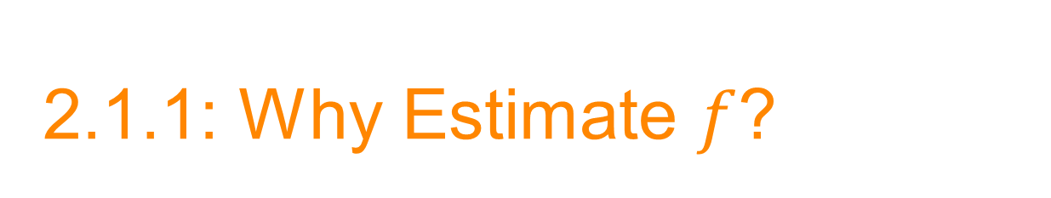
2.1.1: Why Estimate $f$?

Slide 17

2.1.1: Why Estimate $f$?
Prediction
We would like to know which value $Y$ may take based on the values of $X$, not worrying about the form of the relationship between $Y$ and $X$.
Inference
We would like to know the way changes $X$ affect$Y$.

Slide 18

Prediction
We would like to know which value $Y$ may take based on the values of $X$, not worrying about the form of the relationship between $Y$ and $X$.
$\hat{Y}=\hat{f}\left(X\right)$
$\hat{f}$ is the estimate for $f$, treated as a black box
If we do not worry about the form, what do we care about in predicting $Y$ based on $X$?

Slide 19

Prediction
We would like to know which value $Y$ may take based on the values of $X$, not worrying about the form of the relationship between $Y$ and $X$.
$\hat{Y}=\hat{f}\left(X\right)$
$\hat{f}$ is the estimate for $f$, treated as a black box
If we do not worry about the form, what do we care about in predicting $Y$ based on $X$?
Accuracy: How well $Y$ is predicted by $\hat{Y}$

Slide 20

Prediction
What affects accuracy?
reducible error
irreducible error
$$E{\left(Y−\hat{Y}\right)}^{2}=E{\left[f\left(X\right)+ε−\hat{f}\left(X\right)\right]}^{2}={\left[f\left(X\right)−\hat{f}\left(X\right)\right]}^{2}+Var\left(ε\right)$$
Reducible Irreducible
$E{\left(Y−\hat{Y}\right)}^{2}$: Expected value of the difference between he observed and the predicted values of $Y$.
$Var\left(ε\right)$: Variance associated with the error.

Slide 21
Prediction
What affects accuracy?
reducible error: it can be reduced by doing a very good job on predicting
irreducible error: we have to live with it, it due to circumstances out of the hands of the analysts: Unmeasured variables, or variable impossible to be measured

Slide 22

Inference
Understanding the way changes $X$ affect$Y$
$\hat{f}$ cannot be treated as a black box
Which predictors are associated with the response?
What is the relationship between the response and each predictor?
Can the relationship between Y and each predictor be adequately summarized using a linear equation, or is the relationship more complicated?
Here we are not only interested on how accurate is the model, but how easy to interpret it is.

Slide 23
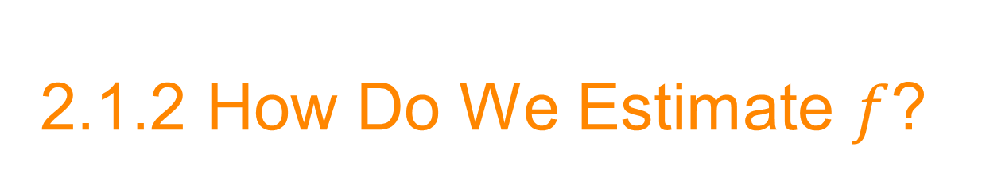
2.1.2 How Do We Estimate $f$?

Slide 24
2.1.2 How Do We Estimate $f$?
Parametric Methods
Non-parametric Methods

Slide 25
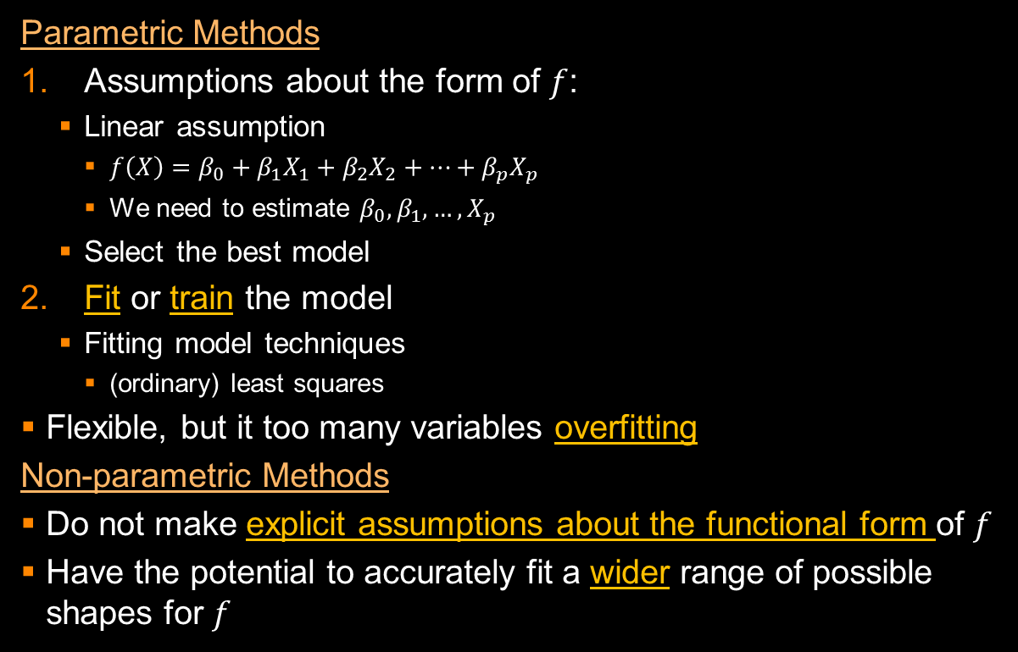
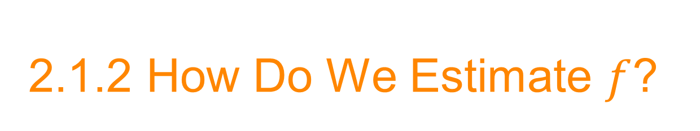
2.1.2 How Do We Estimate $f$?
Parametric Methods
Assumptions about the form of $f$:
Linear assumption
$f\left(X\right)=β_{0}+β_{1}X_{1}+β_{2}X_{2}+…+β_{p}X_{p}$
We need to estimate $β_{0},β_{1}, …,X_{p}$
Select the best model
Fit or train the model
Fitting model techniques
(ordinary) least squares
Flexible, but it too many variables overfitting
Non-parametric Methods
Do not make explicit assumptions about the functional form of $f$
Have the potential to accurately fit a wider range of possible shapes for $f$

